Slide 1



HW components
Dice
Robot’s Head – (Servo,Magnet)
Arduino Manager
Protocol Converter
Robot (GRBL)
LED Screen
Game Manager (PC)
Camera

Slide 2
SW components
Offline simulation
Dice
Game
Camera
Computer Vision
Neural Networks
Python SW
HW
Arduino Manager
Board Maneuvers
Auto Player

Slide 3
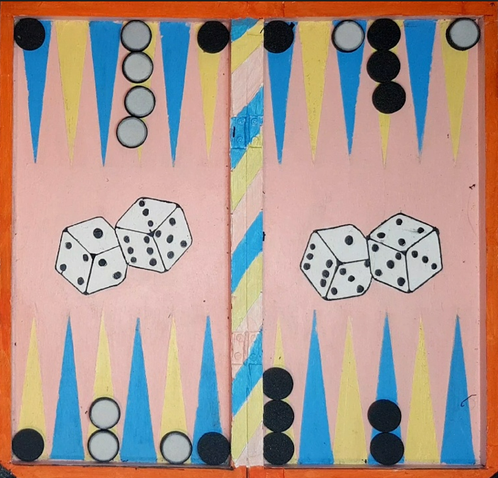

Slide 4
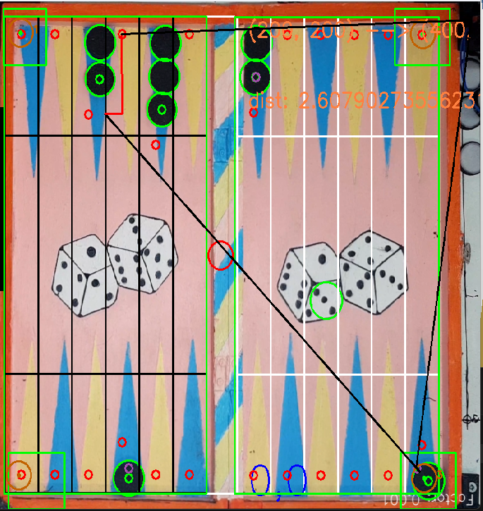
3
1
2

